Slide 1
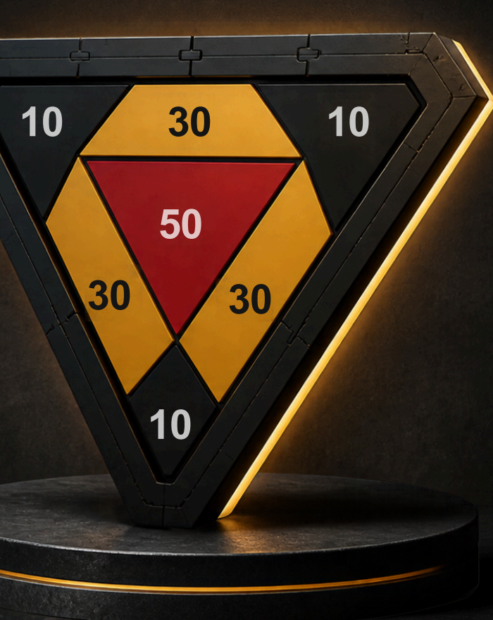
GEST 3005 · DUAL-TASK PROTOTYPE
Smart Dual-Task
Dartboard System
An interactive rehabilitation game combining
FSR force sensing and EEG monitoring
智能雙任務飛鏢靶
Isaac · Adrian
2 November 2026
Notes:
Adrian opens. This is a prototype of a rehabilitation game, not a medical device. The live demo today is the FSR dartboard. EEG is in the recorded video.

Slide 2
The problem and our solution
問題與解法
Who it is for
The problem
People with ADHD, dementia, or recovering after a serious accident. Therapy has to hold their attention.
Standard cognitive and physical rehab repeats the same drills. Patients get bored and stop showing up.
Our solution
Why darts [1]
Gamification. A pub game becomes a scored session that records the throw and the player's state.
A 2024 pilot used a darts game with older adults, with and without mild cognitive impairment.
Notes:
Adrian: Hello everyone. Today we are presenting a system that is more than just a game; it has the potential to be a rehabilitation tool. For patients dealing with ADHD, dementia, or physical injuries, traditional therapy can be boring. We decided to turn darts into a medical tool. Why darts? Because throwing a dart is a dual-task exercise — it challenges physical coordination and mental focus at the same time. A 2024 pilot study by Kawabata and colleagues used a darts intervention with older adults with and without mild cognitive impairment. We cite that as motivation, not as proof that our board treats anyone.

Slide 3
The dual-task concept
雙任務概念
Physical
Mental
01
Center-of-pressure shifting
01
Spatial perception
02
Limb and trunk stabilization
02
Motor learning
03
Balance held through the throw
03
Distance, aim, and memory
[1] Kawabata et al., Front. Rehabil. Sci. 5:1327494, 2024. A pilot study. It motivates the framing. It does not validate this board as therapy.
Notes:
Isaac: What is a dual-task? It means the brain and the body have to work in the same action. Physically, a throw shifts the center of pressure and asks the trunk and the throwing arm to stay stable. Mentally, the player judges distance and learns the motion. Kawabata et al. (2024) tested a darts-game intervention in older adults with and without mild cognitive impairment. That paper is a pilot. Our system aims to monitor both the physical throw and the cognitive state during it. We are not claiming a treatment effect.

Slide 4
Hardware integration
硬件整合
Muse 2
EEG headband
Brain-signal stream
01
02
03
Arduino
Python
Feedback
Reads A0–A3
Sends the hit
Aligns EEG
with force
Score, prompt,
progress
FSR board
4 sensors, triangular face
Hit zone and force
Muse 2 over Bluetooth. FSR board over serial. Python is where the two clocks meet.
Notes:
Adrian: For the hardware, we combined two sets of sensors. First, our custom 3D-printed triangular dartboard with 4 FSRs to measure the physical throw. Second, the Muse 2 headband to measure brain activity. The Arduino reads the FSR dividers and sends the hit onward. Python on the laptop combines that stream with the EEG data. The screen then shows the score and the prompt.

Slide 5
The live game loop
遊戲循環
01
02
03
04
Sync
Baseline
Throw
Feedback
Python lines up the EEG stream and the FSR stream on one clock.
Record the resting cognitive state before the first throw.
The hit reports zone and force. EEG is captured in the same window.
The screen shows the score, a prompt, and the running session.
Later analysis compares brain signals in distracted windows with signals in focused windows.
Notes:
Isaac: Here is how it works. The computer first measures the patient's baseline brainwaves at rest. Then, as they throw, the Python program combines the FSR force data with the EEG data. We can then look at whether a more focused window lines up with a better throw. We compare distracted and focused states. We do not treat that comparison as a diagnosis.

Slide 6
How we built it
建造方法
Fusion 360
Tinkercad
Four face tiles, snap-fits, and the triangular envelope. About 262 mm on a side.
Uno, four FSR dividers, 16×2 LCD, piezo, and a 9 V battery through VIN.
VS Code
Optional AI layer
Arduino C++ scores the hit. Python aligns that serial line with the EEG stream.
Explored for therapy notes, literature lookup, and spoken prompts. Not in the live demo.
Notes:
Adrian: For the build, we used Fusion 360 to design the 3D dartboard and Tinkercad to simulate the circuits. The software is written in Python and Arduino. We also explored adding an AI layer to draft progress notes for a therapist or to speak a prompt to the player. That layer is exploratory. Today's demo is the sensor board.

Slide 7
Limitations and disclaimer
限制與聲明
Exploratory prototype
01
This is not a proven treatment for ADHD, dementia, or rehabilitation. It is a student system that records a throw.
EEG is a proxy
02
Signals from the Muse 2 do not measure attention directly. They are a stand-in for cognitive load.
The paper is a pilot
03
Kawabata et al. studied older adults with and without MCI. It motivates darts as a dual-task. It does not validate this board.
Notes:
Isaac: We want to be very clear. This is an experimental prototype. We are not claiming it treats ADHD, because EEG signals do not directly equal attention. Kawabata et al. 2024 is a pilot in older adults with and without mild cognitive impairment. It is why we frame darts as a dual-task. It is not evidence that our hardware works as therapy. Real medical use would need clinical trials and a clinician in the loop.

Slide 8
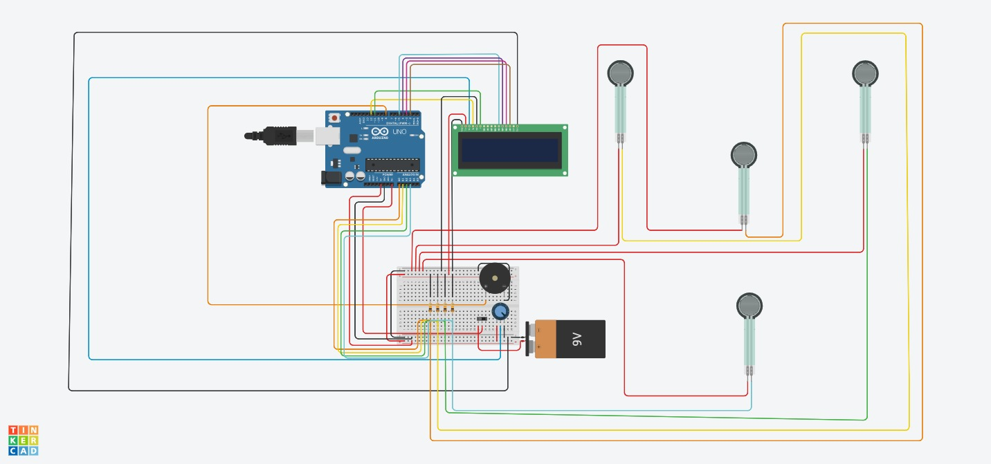
Live demo — FSR dartboard
現場示範
Power on
01
LCD reads Dartboard ready / Score: 0.
One throw
02
A classmate or the professor throws, or presses one sensor.
Read the hit
03
LCD shows the zone and LIGHT, MEDIUM, or HARD. The piezo marks the band.
EEG sync is in the recorded video, not in this room.
Notes:
Isaac and Adrian: Due to the live environment, we will focus on demonstrating the physical FSR dartboard today. Power on, the LCD says ready. One throw, and the display shows the zone, the force band, and the score. The buzzer pitch follows light, medium, or hard. The full EEG integration is in the demo video.

Slide 9
Conclusion
總結
Framework
If asked
A simple FSR scorer is now a dual-task session: force and brain signals on one timeline.
Does EEG measure focus?
No. The result is a synced framework for later analysis.
What we combined
Why not a shop dartboard?
Those boards only keep score. Ours keeps raw force for research.
3D-printed faces, four FSRs, a Muse 2, Arduino scoring, and a Python aligner.
Why darts?
COP shift, trunk stability, spatial perception, motor learning. [1]
What we claim
Gamification can hold attention. We do not claim a clinical effect.
Notes:
Adrian: To conclude, we believe darts can be more than a pub game. With force sensors and a synced EEG stream, it can be a rehabilitation framework. Thank you.
Q&A — If asked how EEG proves focus: EEG does not equal focus. The achievement is the framework that syncs physical force with brainwave data for future dual-task analysis.
If asked why not a commercial electronic dartboard: commercial boards only track scoring. Our board captures raw analog force and can synchronize it with EEG.
If asked why darts rather than another game: one throw demands a center-of-pressure shift, trunk stability, spatial perception, and motor learning. Kawabata et al., 2024, is the pilot we point to. doi: 10.3389/fresc.2024.1327494.

